Slide 1
Nextiva Mobile App Training

Slide 2
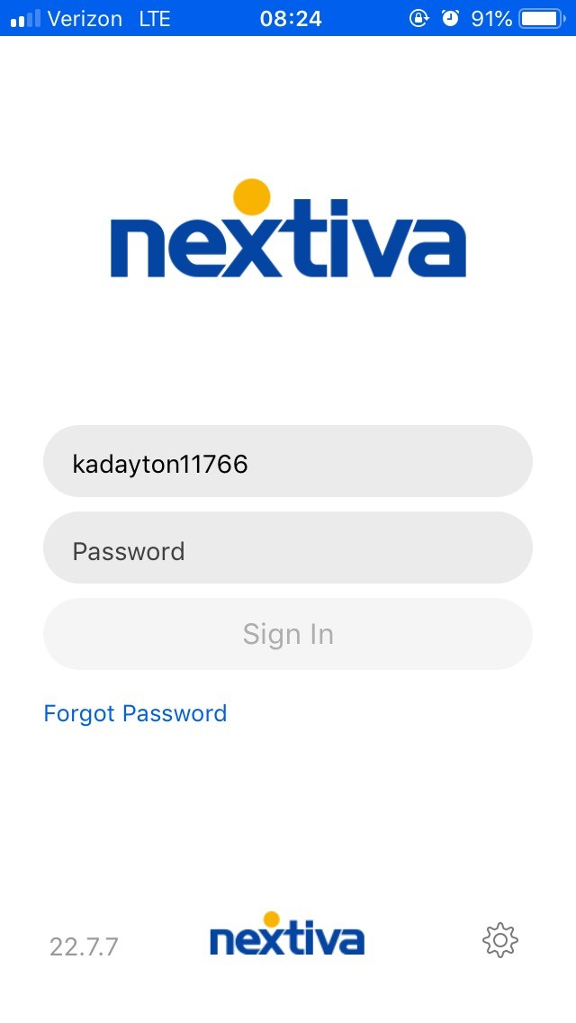
What is the Nextiva Mobile App? How do I get the App?
The Nextiva Mobile App is an Application
designed to enable your mobile device to
make calls as if you were in the office.
All calls that come to your extension will
simultaneously ring the App when you are signed in.
You can easily log out of the App to prevent
calls from coming to the App. You can
essentially “forward/unforward” calls to
your mobile device simply by signing in/out.
The App uses the data side of Cellular/Wifi
connections. Wifi is always recommended for
the best App experience.
You can obtain the App either in the Google Play
Store (Android) or the App Store (Apple iOS).
Your login information (if not sent already) will be
sent to you by your Nextiva Admin. You can reset
your password via the link included in the e-mail
and login to the App afterward.

Slide 3
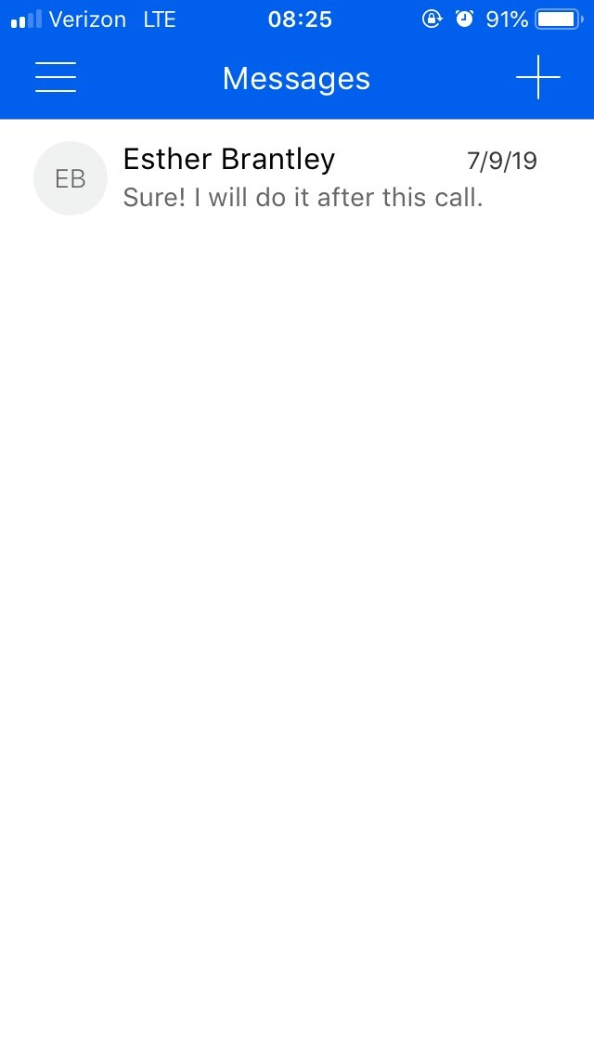
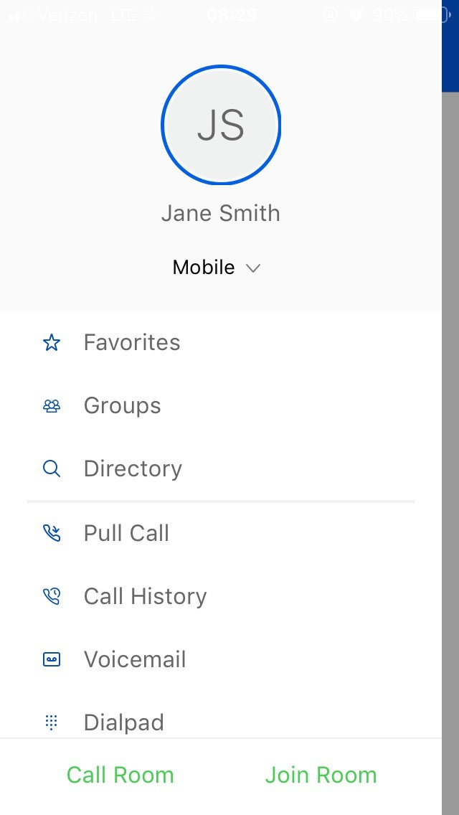
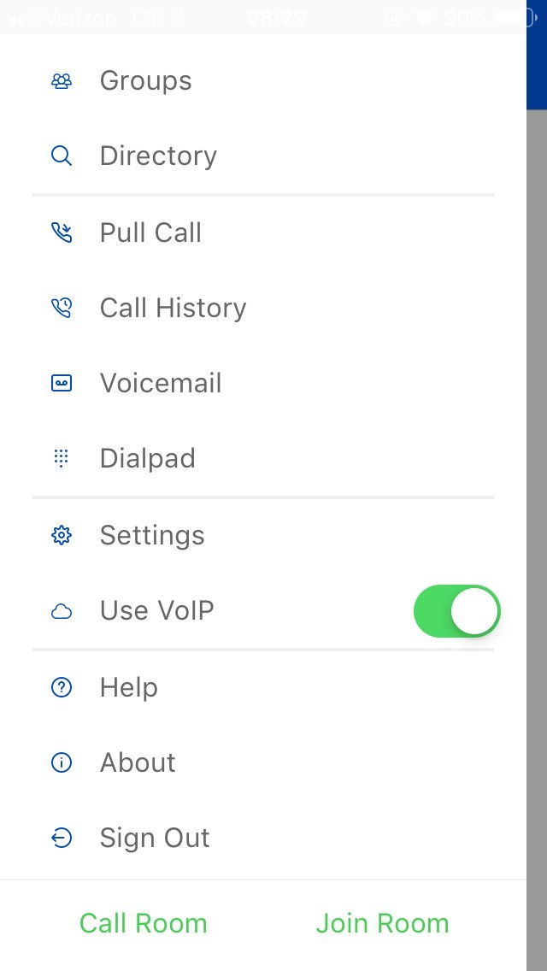
Nextiva App Main Screen
Default view:
The default screen when inside the app will always show your messages:
Press the Menu button in the upper-left corner to access other parts of the app:

Slide 4
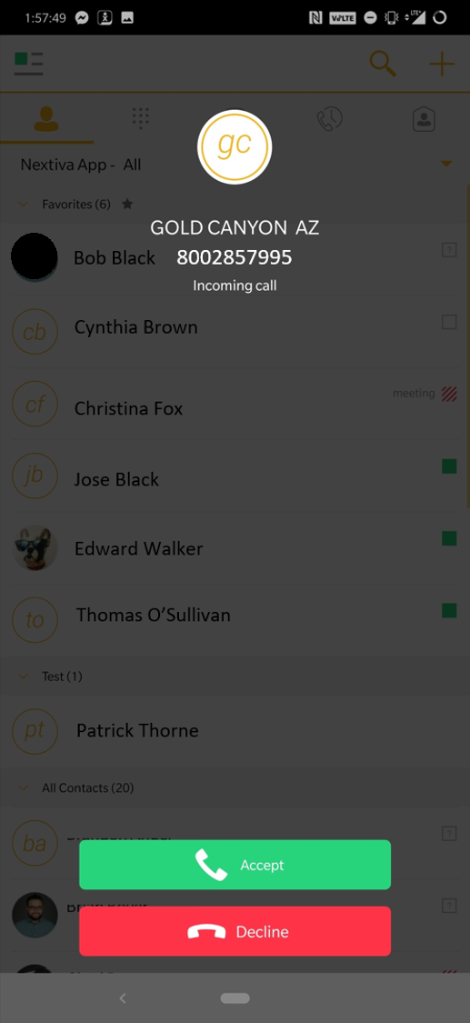
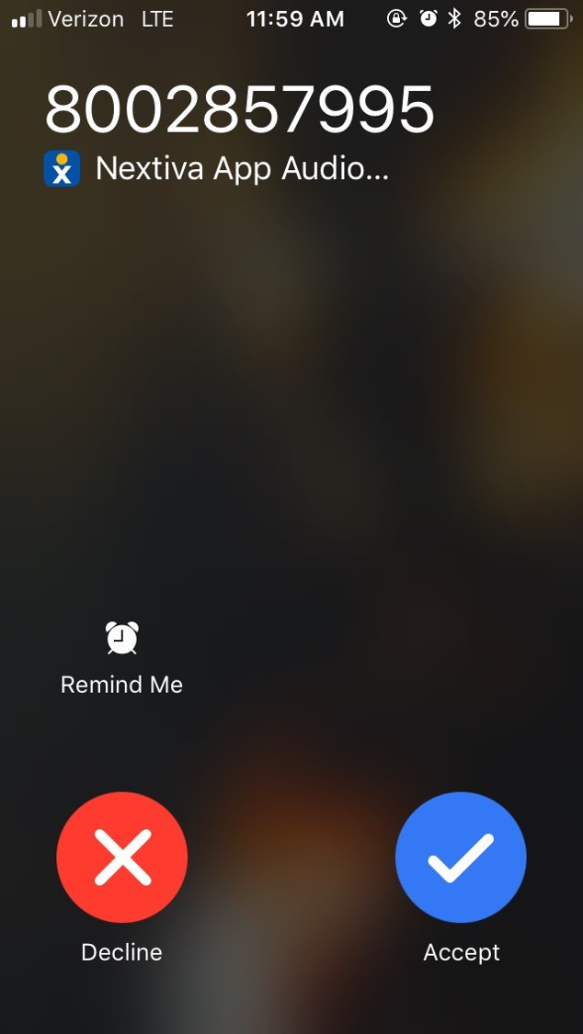
Inbound Calls
Android
Apple iOS

Slide 5
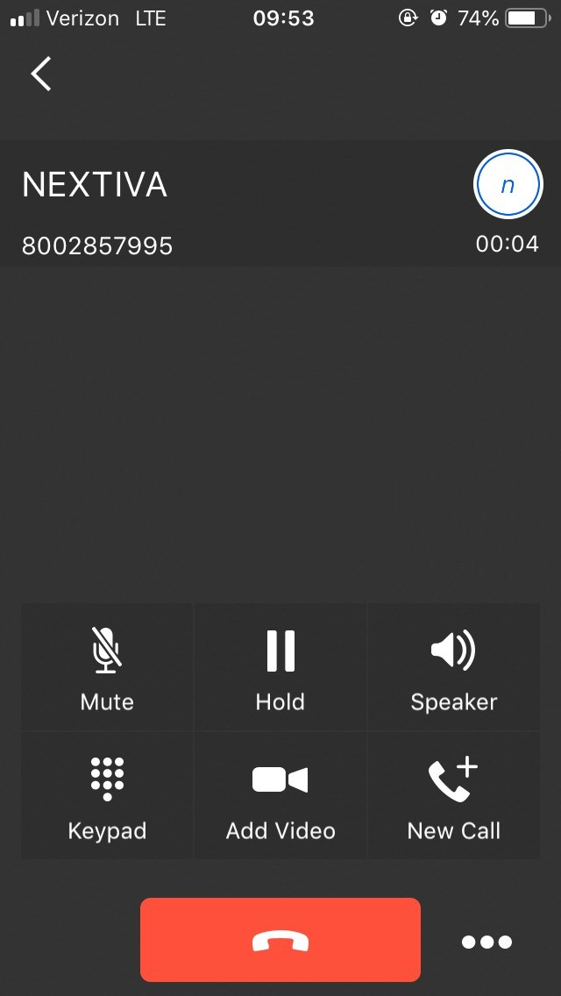
Inbound Calls – In progress
Note: This screen is the same for both Android and iPhone devices.

Slide 6
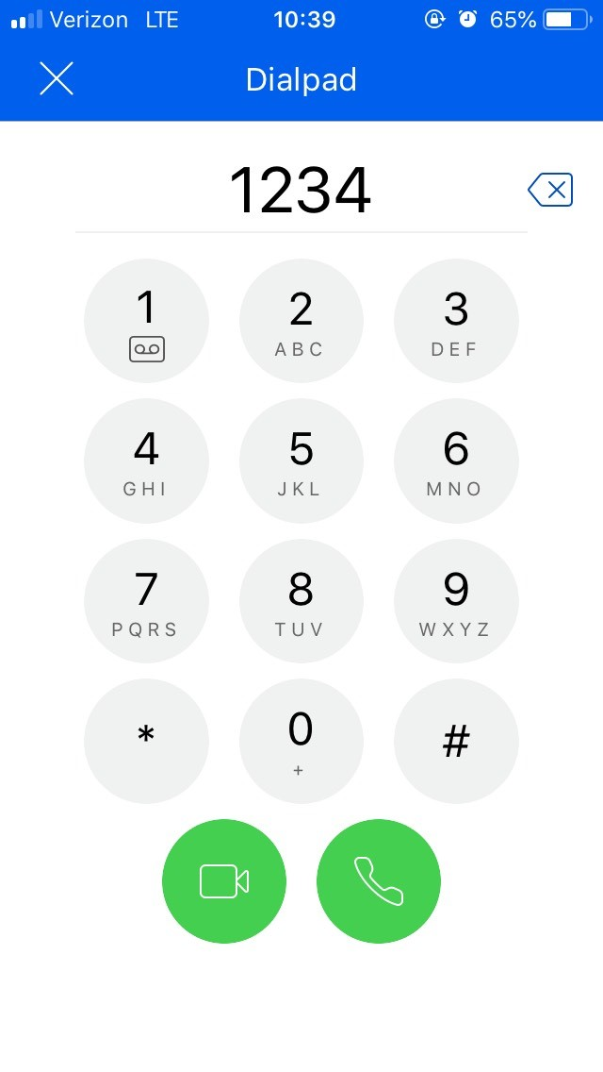
Outbound Calls
Dial Pad
To dial outbound, access your menu in the upper-left hand corner and press “Dialpad”.
When dialing outbound, always use a ten-digit number.
You can also enter an extension. The App can reach any extension you can dial with a desk phone.

Slide 7
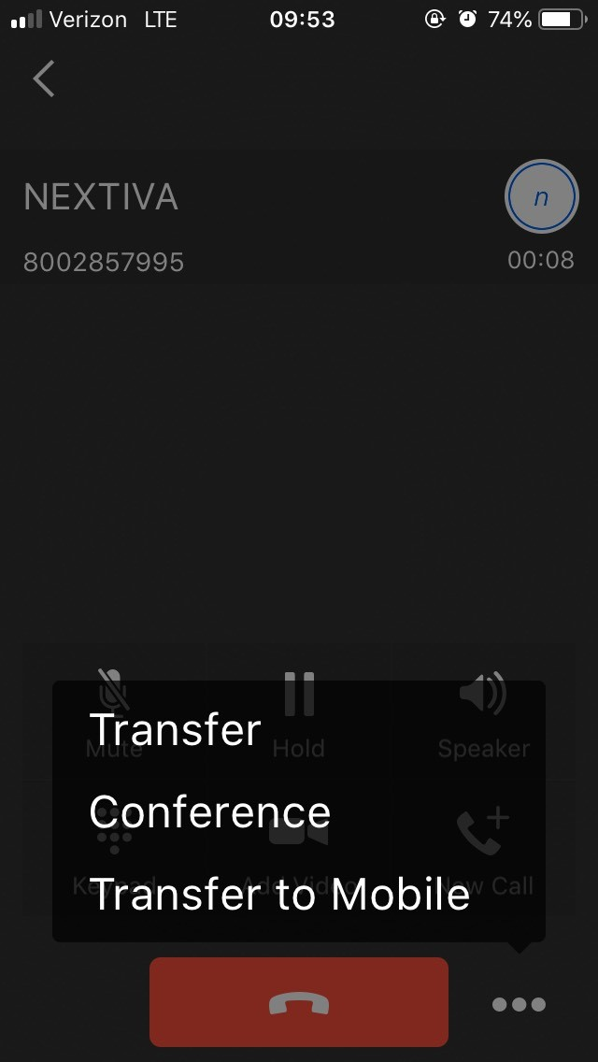
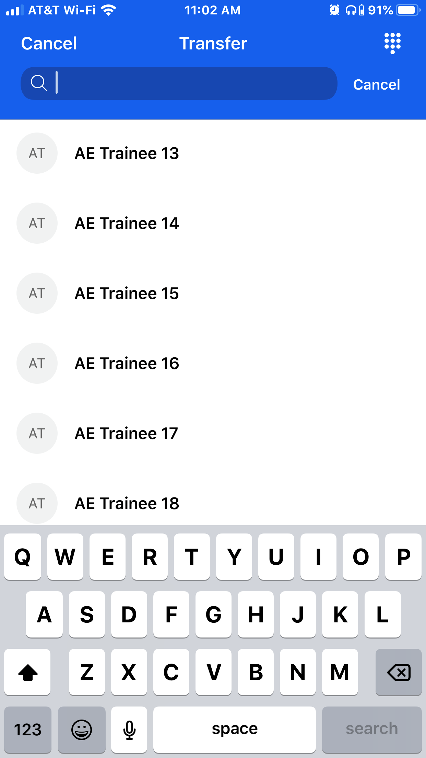
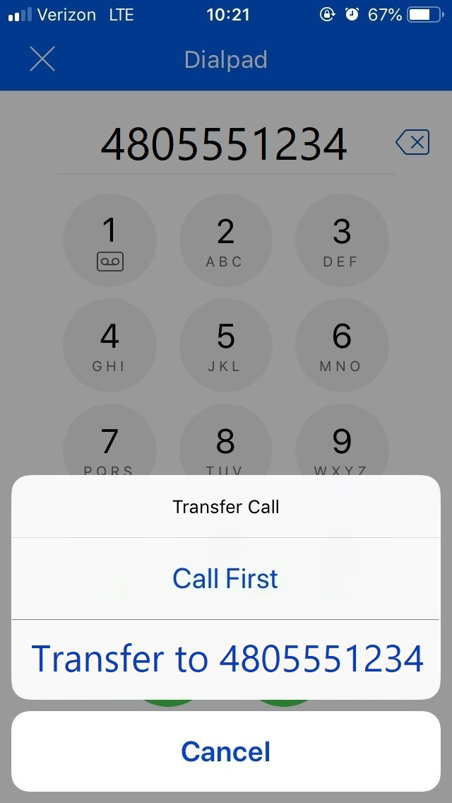
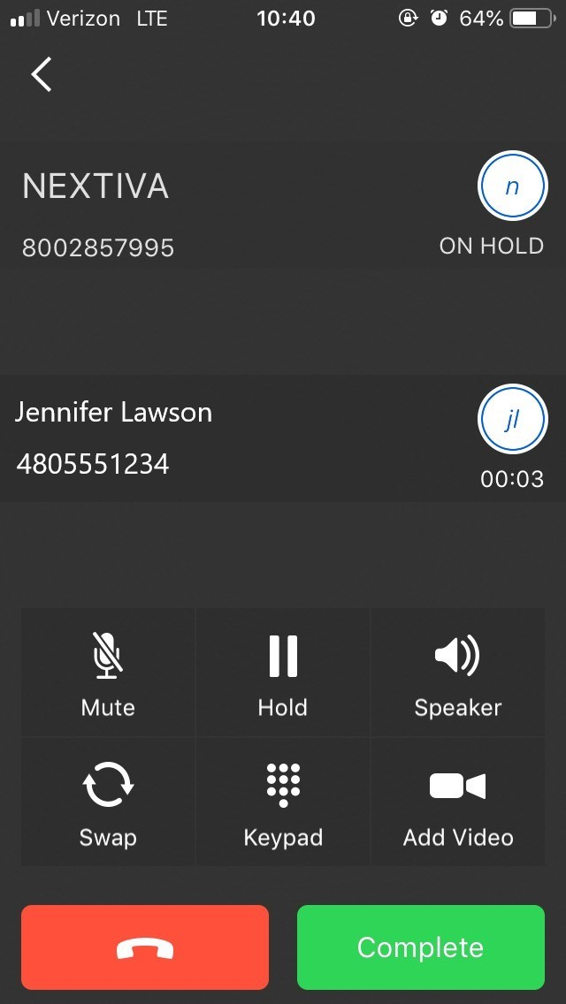
Transferring Calls
To transfer calls, when on an active call, press the 3 dots next to the end call button to bring up the transfer menu.
Press “Transfer”.
Enter the name of the contact you want to transfer to. Or press the dial pad icon in the upper-right hand corner.
To Blind Transfer: Press the “Transfer to:” option. The call will be blind transferred immediately.
To Warm Transfer: Press “Call First”. You will see both calls active. Press “Complete” when finished.

Slide 8
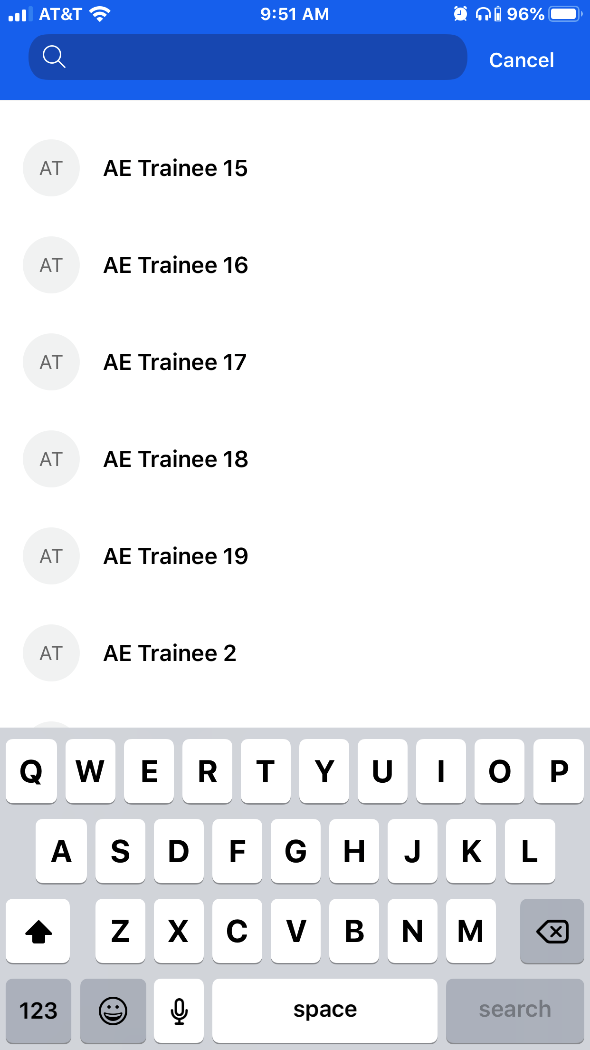
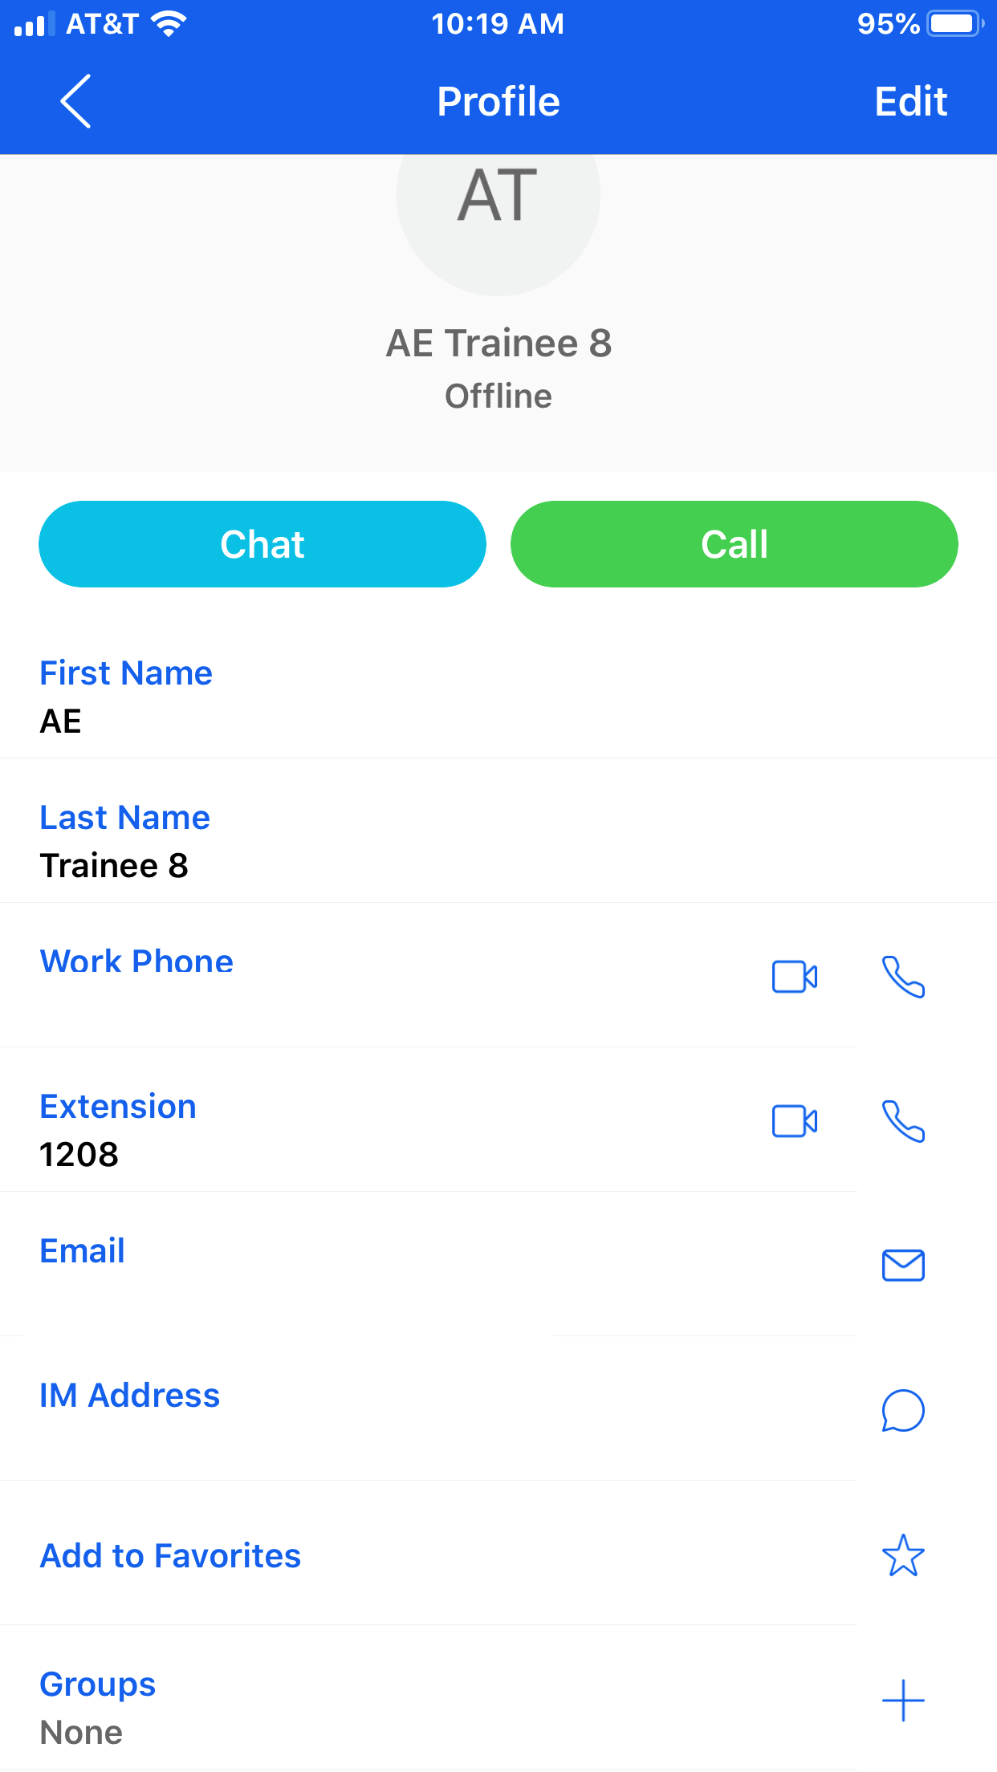
Contacts
You can access your directory by pressing the menu in the upper-left hand corner, and then pressing “Directory”.
The directory will contain a list of all contacts in the Nextiva account. You can search for a contact to pull up their contact card. If allowed once the app is launched, you can also search through the contacts contained in your mobile device’s phone book.
After pressing on a contact, you will be shown all the contact phone numbers/extensions and can add them to favorites/groups.

Slide 9
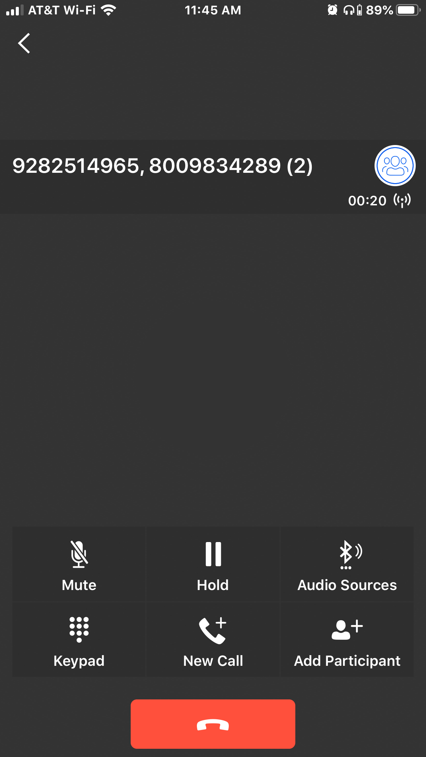
Conference Calls
Conference calls can be initiated by hitting the 3 dots while on a call and pressing “Conference”.
You can search for a contact or press the dial pad in the upper-right hand corner to dial a number. Once dialed, the call will be instantly brought together.
You can add participants to your conference by hitting the “Add Participant button” and dialing out to other contacts.
  NOTE: If you hang up the conference, everyone will be disconnected.

Slide 10
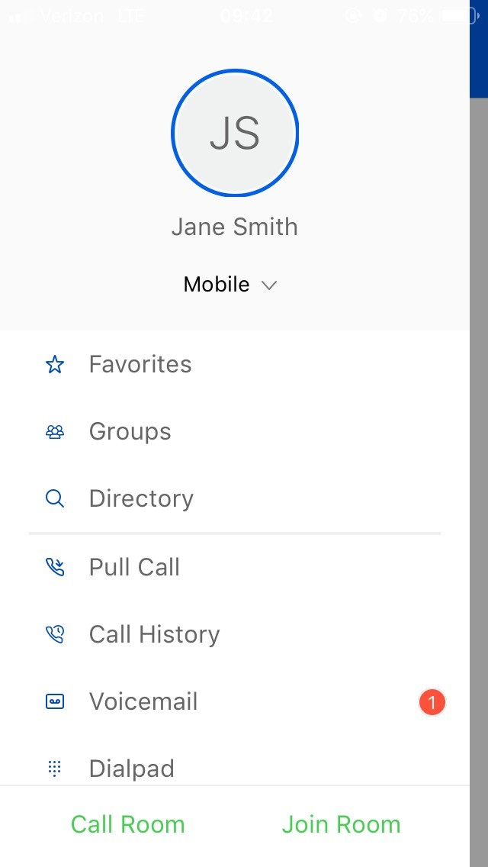
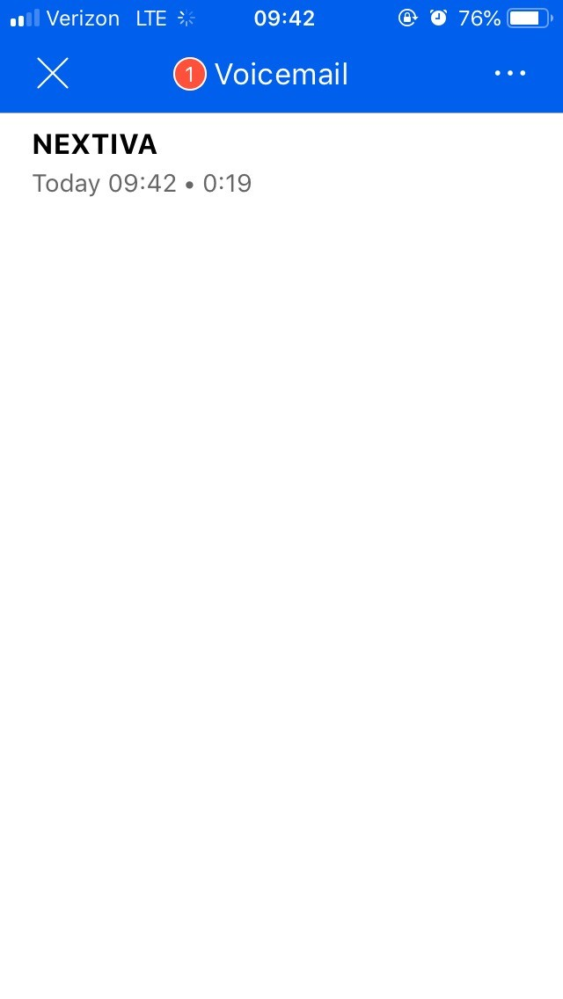
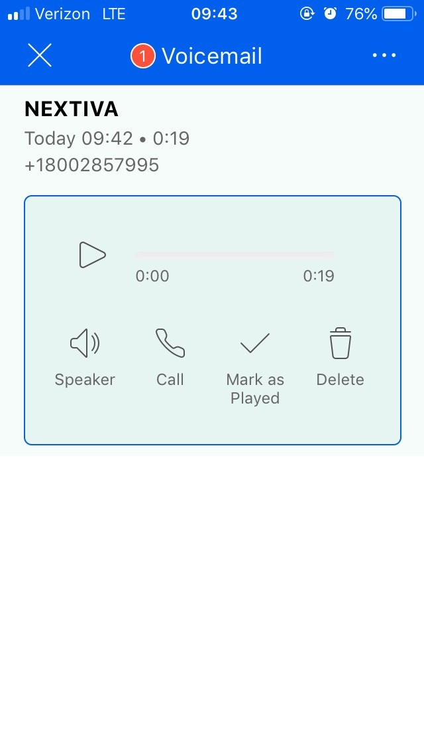
Voicemail
Voicemail can be accessed by pressing on the menu icon in the upper-left hand corner and pressing “Voicemail”. This will also indicate how many new voicemails you have.
Once accessed, you will see the list of voicemails. You can select a voicemail and will be provided with the options to: Play, play over speaker, call the contact back, delete the voicemail.
Any voicemails deleted from the app will be deleted from the desk phone the app is sharing from (if applicable).

Slide 11
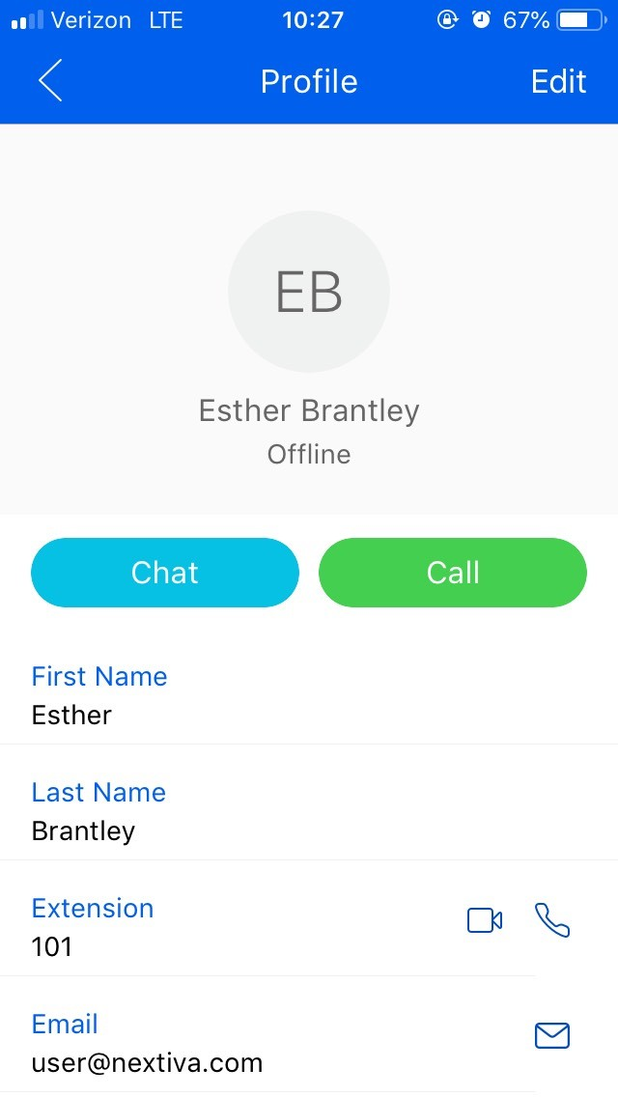
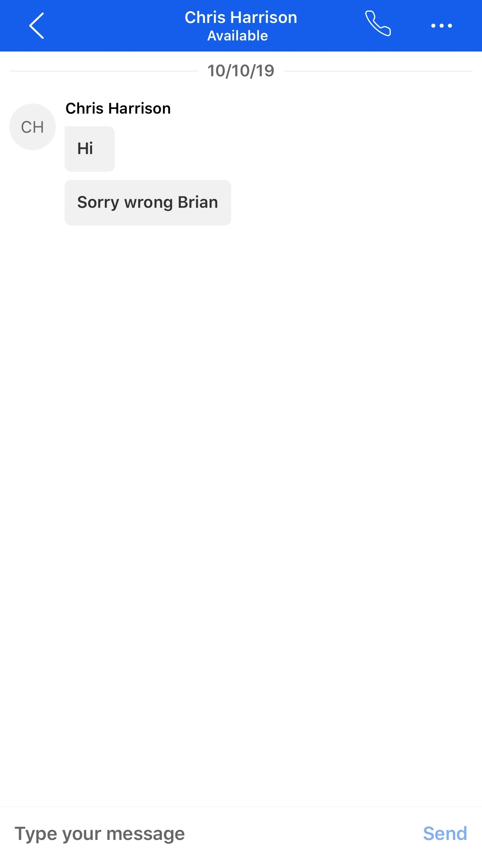
Chat
To chat with a Nextiva user, access your directory to locate the user you wish to chat with. Press on the user’s name, then press the “Chat” button.
The user’s chat history will display. You can then press the message box to bring up the keyboard to begin typing to the user. Press “Send” to send your message.
Once finished, press the back arrow in the upper-left hand corner to be taken back to the default screen where all your message history will be located.
  NOTE: You can also press the “+” button in the upper-right hand corner of the default screen to search for a contact to chat with once you have located them in the search.

Slide 12
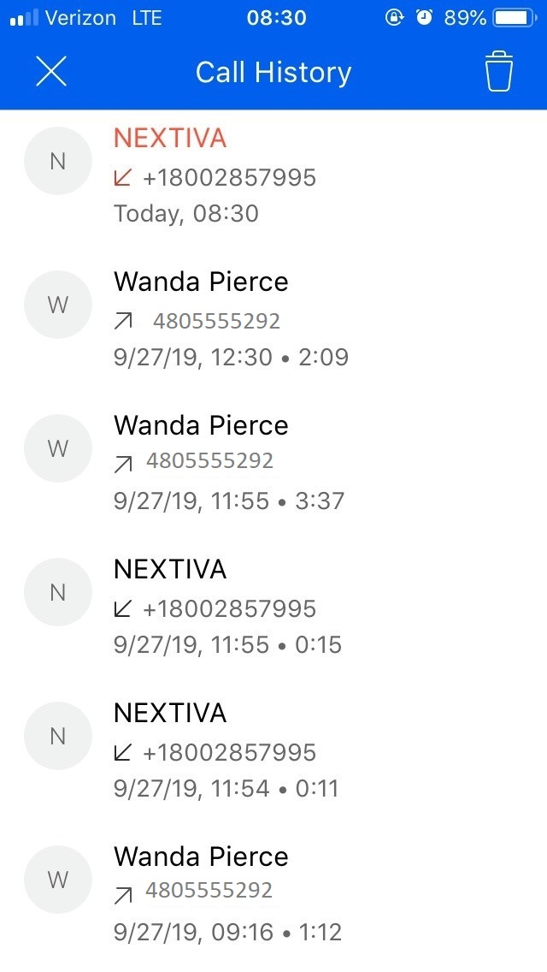
Call History
You can check call history by accessing the menu and pressing “Call History”.
The call history will be displayed. The
arrows will indicate whether calls were
inbound (pointing away from the number) or outbound (pointing at the number).
A missed call will be highlighted red.

Slide 13
Pull Calls
Pull Call allows you to take a phone call on another Nextiva device (desk phone, desktop app) and bring it to the mobile app.
Access the menu in the upper-left hand corner of the app and select “Pull Call”. Any active call occurring on your extension will be brought to the Nextiva App.
This function is also available from a desk phone. During a dial tone, dial *11 and the call from your Nextiva App will be brought to the desk phone.

Slide 14

Any questions?

